Slide 1

ENSN201 – Enterprise Social Networks
Version 2 – 18th December 2015

Slide 2
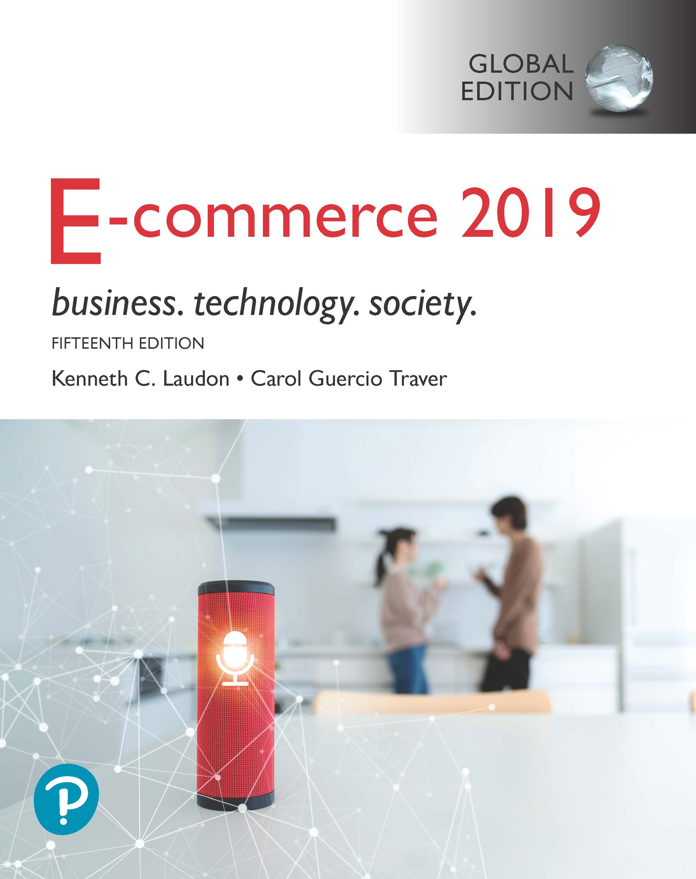
Resource Material
E-commerce 2019: Business, Technology and Society, Global Edition, 15th Edition
ISBN / EAN: 9781292303178
by Kenneth C. Laudon and Carol Guercio Traver

Slide 3
E-commerce 2019: Business. Technology. Society.
Fifteenth Edition, Global Edition
Chapter 4
E-commerce Security and Payment Systems
Copyright © 2020 Pearson Education Ltd. All Rights Reserved
Notes:
If this PowerPoint presentation contains mathematical equations, you may need to check that your computer has the following installed:
1) MathType Plugin
2) Math Player (free versions available)
3) NVDA Reader (free versions available)

Slide 4
Learning Objectives
4.1 Understand the scope of e-commerce crime and security problems, the key dimensions of e-commerce security, and the tension between security and other values.
4.2 Identify the key security threats in the e-commerce environment.
4.3 Describe how technology helps secure Internet communications channels and protect networks, servers, and clients.
4.4 Appreciate the importance of policies, procedures, and laws in creating security.
4.5 Identify the major e-commerce payment systems in use today.
4.6 Describe the features and functionality of electronic billing presentment and payment systems.

Slide 5
The Rise of the Global Cyberattack
Class Discussion
Have you or anyone you know been the subject of a cybercrime? If so, what happened?
Do you think an agreement among countries akin to the Geneva Convention will be an effective deterrent for cybercrime? Why or why not?
What steps have you taken to protect yourself online?

Slide 6
The E-commerce Security Environment
Scope of the problem
Overall size of and losses due to cybercrime unclear
McAfee/Center for Strategic and International Studies study: Global economic impact of cybercrime and cyberespionage between $455 billion to $600 billion
Reports by security product providers indicate increasing cybercrime
Online credit card fraud one of the most high-profile forms
Underground economy marketplaces sell stolen information, malware and more

Slide 7
What is Good E-commerce Security?
To achieve highest degree of security
New technologies
Organizational policies and procedures
Industry standards and government laws
Other factors
Time value of money
Cost of security versus potential loss
Security often breaks at weakest link

Slide 8
Figure 4.1 The E-commerce Security Environment
Notes:
Figure 4.1, Page 260.
E-commerce security is multi-layered, and must take into account new technology, policies and procedures, and laws and industry standards.
Full description: A bulls-eye diagram depicts the multi-layered nature of the e-commerce security environment. The diagram has Data in center. There are four concentric ovals. From the inner-most oval to the outer-most one, the ovals are labeled as follows, Technology Solutions, Organizational Policies and Procedures, and Laws and Industry Standards.

Slide 9
Table 4.3 Customer and Merchant Perspectives on the Different Dimensions of E-commerce Security
Dimension | Customer’s Perspective | Merchant’s Perspective
Integrity | Has information I transmitted or received been altered? | Has data on the site been altered without authorization? Is data being received from customers valid?
Nonrepudiation | Can a party to an action with me later deny taking the action? | Can a customer deny ordering products?
Authenticity | Who am I dealing with? How can I be assured that the person or entity is who they claim to be? | What is the real identity of the customer?
Confidentiality | Can someone other than the intended recipient read my messages? | Are messages or confidential data accessible to anyone other than those authorized to view them?
Privacy | Can I control the use of information about myself transmitted to an e-commerce merchant? | What use, if any, can be made of personal data collected as part of an e-commerce transaction? Is the personal information of customers being used in an unauthorized manner?
Availability | Can I get access to the site? | Is the site operational?

Slide 10
The Tension between Security and Other Values
Ease of use
The more security measures added, the more difficult a site is to use, and the slower it becomes
Public safety and criminal uses of the Internet
Use of technology by criminals to plan crimes or threaten nation-state

Slide 11
Security Threats in the E-commerce Environment
Three key points of vulnerability in e-commerce environment:
Client
Server
Communications pipeline (Internet communications channels)

Slide 12
Figure 4.2 A Typical E-commerce Transaction
Notes:
Figure 4.2, Page 264.
In a typical e-commerce transaction, the customer uses a credit card and the existing credit payment system.
Full description: A flow diagram depicts a typical e-commerce transaction. The steps involved in the transaction are as follows. An Online consumer contacts an Online store through an Internet service provider. The online store uses a Merchant website and Merchant web server which connects with a Database server which connects with a Warehouse. The Customer credit card bank transacts with the Merchant bank through the Merchant website and Merchant Web servers. All of the above transactions and connections are two-way. Last, the Warehouse uses a Shipping service to ship the product to the Online consumer.

Slide 13
Figure 4.3 Vulnerable Points in an E-commerce Transaction
Notes:
Figure 4.3, Page 265.
There are three major vulnerable points in e-commerce transactions: Internet communications, servers, and clients.
Full description: A flow diagram depicts the vulnerable points in an e-commerce transaction. The steps involved in the transaction are as follows. An Online consumer contacts an Online store through an Internet service provider. The online store uses a Merchant website and Merchant web server which connects with a Database server which connects with a Warehouse. The Customer credit card bank transacts with the Merchant bank through the Merchant website and Merchant Web servers. All of the above transactions and connections are two-way. Last, the Warehouse uses a Shipping service to ship the product to the Online consumer.
Vulnerable points in the process include web beacons in the Online consumer’s system, Wi-Fi listening wiretaps in the connection between the consumer and Internet service provider, Customer list hacks in the online store’s system, S Q L injection attacks on the database server, D O S attacks, card theft, or hacking at the customer credit card bank’s end, and security breaches at the point where the Customer credit card bank, Merchant bank, and the Merchant web servers and Merchant website connect, and when the order is shipped to the Online consumer.

Slide 14
Malicious Code
Exploits and exploit kits
Malvertising
Drive-by downloads
Viruses
Worms
Ransomware
Trojan horses
Backdoors
Bots, botnets

Slide 15
Potentially Unwanted Programs
Browser parasites
Monitor and change user’s browser
Adware
Used to call pop-up ads
Spyware
Tracks users keystrokes, e-mails, I M s, etc.

Slide 16
Phishing
Any deceptive, online attempt by a third party to obtain confidential information for financial gain
Tactics
Social engineering
E-mail scams and B E C phishing
Spear phishing
Used for identity fraud and theft

Slide 17
Hacking, Cybervandalism, and Hacktivism
Hacking
Hackers versus crackers
White hats, black hats, grey hats
Tiger teams
Goals: cybervandalism, data breaches
Cybervandalism:
Disrupting, defacing, destroying Web site
Hacktivism

Slide 18
Data Breaches
Organization loses control over corporate information to outsiders
Over 1,575 breaches in 2017, 45% increase over 2016
Yahoo and Equifax two of the most notorious; Facebook breach in 2018 exposed personal information of 30 million
Leading causes
Hacking
Unauthorized access
Employee error/negligence

Slide 19
Insight on Society: Equifax: Really Big Data Hacked
Class Discussion
What organizational and technological failures led to the data breach at Equifax?
What technical solutions are available to combat data breaches?
Have you or anyone you know experienced a data breach?

Slide 20
Credit Card Fraud/Theft
Stolen credit card incidences about 0.9% on the Web and about 0.8% of mobile transactions
Hacking and looting of corporate servers is primary cause
Central security issue: establishing customer identity
E-signatures
Multi-factor authentication
Fingerprint identification

Slide 21
Identity Fraud/Theft
Unauthorized use of another person’s personal data for illegal financial benefit
Social security number
Driver’s license
Credit card numbers
Usernames/passwords
2017: Almost 17 million U.S. consumers suffered identity fraud

Slide 22
Spoofing, Pharming, and Spam (Junk) Websites
Spoofing
Attempting to hide true identity by using someone else’s e-mail or I P address
Pharming
Automatically redirecting a U R L to an different address, to benefit the hacker
Spam (junk) websites
Offer collection of advertisements for other sites, which may contain malicious code

Slide 23
Sniffing and Man-In-The-Middle Attacks
Sniffer
Eavesdropping program monitoring networks
Can identify network trouble spots
Can be used by criminals to steal proprietary information
E-mail wiretaps
Recording e-mails at the mail server level
Man-in-the-middle attack
Attacker intercepts and changes communication between two parties who believe they are communicating directly

Slide 24
Denial of Service (D o S) and Distributed Denial of Service (D D o S) Attacks
Denial of service (D o S) attack
Flooding website with pings and page request
Overwhelm and can shut down site’s web servers
Often accompanied by blackmail attempts
Botnets
Distributed Denial of Service (D D o S) attack
Uses hundreds or thousands of computers to attack target network
Can use devices from Internet of Things, mobile devices
D D o S smokescreening

Slide 25
Insider Attacks
Largest threat to business institutions come from insider embezzlement
Employee access to privileged information
Poor security procedures
Insiders more likely to be source of cyberattacks than outsiders

Slide 26
Poorly Designed Software
Increase in complexity of and demand for software has led to increase in flaws and vulnerabilities
S Q L injection attacks
Zero-day vulnerability
Heartbleed bug; Shellshock (BashBug); F R E A K

Slide 27
Social Network Security Issues
Social networks an environment for:
Viruses, site takeovers, identity fraud, malware-loaded apps, click hijacking, phishing, spam
Manual sharing scams
Sharing of files that link to malicious sites
Fake offerings, fake Like buttons, and fake apps

Slide 28
Mobile Platform Security Issues
Little public awareness of mobile device vulnerabilities
2017: Over 26,500 different mobile malware variants identified by Symantec
Vishing
Smishing
S M S spoofing
Madware

Slide 29
Insight on Technology: Think Your Smartphone is Secure?
Class Discussion
What types of threats do smartphones face?
Are there any vulnerabilities specific to mobile devices?
What qualities of apps make them a vulnerable security point in smartphone use?
Are apps more or less likely to be subject to threats than traditional P C software programs?

Slide 30
Cloud Security Issues
D D o S attacks
Infrastructure scanning
Lower-tech phishing attacks yield passwords and access
Use of cloud storage to connect linked accounts
Lack of encryption and strong security procedures

Slide 31
Internet of Things Security Issues
Challenging environment to protect
Vast quantity of interconnected links
Near identical devices with long service lives
Many devices have no upgrade features
Little visibility into workings, data, or security

Slide 32
Technology Solutions
Protecting Internet communications
Encryption
Securing channels of communication
S S L, T L S, V P N s, Wi-Fi
Protecting networks
Firewalls, proxy servers, I D S, I P S
Protecting servers and clients
O S security, anti-virus software

Slide 33
Figure 4.5 Tools Available to Achieve E-commerce Security
Notes:
Figure 4.5, Page 288.
There are a number of tools available to achieve e-commerce security.
Full description: A diagram depicts the different tools available to achieve e-commerce security. The diagram shows Security Management in the center and the following points surrounding it. Firewalls, Encryption, Network Security Protocols, Virtual Private Networks, Authentication Procedures, Proxy Servers, Anti-Virus Software, Automated Software Updates, Intrusion Detection and Prevention.

Slide 34
Encryption
Encryption
Transforms data into cipher text readable only by sender and receiver
Secures stored information and information transmission
Provides 4 of 6 key dimensions of e-commerce security:
Message integrity
Nonrepudiation
Authentication
Confidentiality

Slide 35
Symmetric Key Cryptography
Sender and receiver use same digital key to encrypt and decrypt message
Requires different set of keys for each transaction
Strength of encryption: Length of binary key
Data Encryption Standard (D E S)
Advanced Encryption Standard (A E S)
Other standards use keys with up to 2,048 bits

Slide 36
Public Key Cryptography
Uses two mathematically related digital keys
Public key (widely disseminated)
Private key (kept secret by owner)
Both keys used to encrypt and decrypt message
Once key used to encrypt message, same key cannot be used to decrypt message
Sender uses recipient’s public key to encrypt message; recipient uses private key to decrypt it

Slide 37
Figure 4.6 Public Key Cryptography: A Simple Case
Notes:
Figure 4.6, Page 291.
In the simplest use of public key cryptography, the sender encrypts a message using the recipient’s public key, and then sends it over the Internet. The only person who can decrypt this message is the recipient, using his or her private key. However, this simple case does not ensure integrity or an authentic message.
Full description: An image illustrates a simple use of public key cryptography and the important steps in using public and private keys. The steps are as follows. First, the sender creates an original digital message, to buy X Y Z at the rate of 100 dollars. Second, the sender obtains the recipient’s public key and applies it to the message. Third, this message gets encrypted in cipher text, depicted as 1 0 1 0 1 1 0 1 1 1 0 0 0 1. Fourth, the message is sent over the Internet. And fifth, the message is received by the recipient, who uses his or her private key to decrypt the message..

Slide 38
Public Key Cryptography Using Digital Signatures and Hash Digests
Sender applies a mathematical algorithm (hash function) to a message and then encrypts the message and hash result with recipient’s public key
Sender then encrypts the message and hash result with sender’s private key-creating digital signature-for authenticity, nonrepudiation
Recipient first uses sender’s public key to authenticate message and then the recipient’s private key to decrypt the hash result and message

Slide 39
Figure 4.7 Public Key Cryptography with Digital Signatures
Notes:
Figure 4.7, Page 292.
A more realistic use of public key cryptography uses hash functions and digital signatures to both ensure the confidentiality of the message and authenticate the sender. The only person who could have sent the above message is the owner or the sender using his/her private key. This authenticates the message. The hash function ensures the message was not altered in transit. As before, the only person who can decipher the message is the recipient, using his/her private key.
Full description: An image illustrates the steps of public key cryptography with digital signatures. The steps are as follows. First, the sender creates an original digital message, to buy X Y Z at the rate of 52 dollars. Second, the sender applies a hash function, which produces a hash digest. Third, the sender encrypts the message and has digest using the recipient's public key. Fourth, the sender encrypts the result, using the sender's private key, or digital signature. Fifth, the message, now in the form of double-encrypted signed cipher text is sent via the Internet. Sixth, the message then reaches the receiver, who uses the sender's public key to get authenticated cipher text. Seventh, the receiver then uses his or her private key to decrypt the hash function and original message.

Slide 40
Digital Envelopes
Address weaknesses of:
Public key cryptography
Computationally slow, decreased transmission speed, increased processing time
Symmetric key cryptography
Insecure transmission lines
Uses symmetric key cryptography to encrypt document
Uses public key cryptography to encrypt and send symmetric key

Slide 41
Figure 4.8 Public Key Cryptography: Creating a Digital Envelope
Notes:
Figure 4.8, Page 294.
A digital envelope can be created to transmit a symmetric key that will permit the recipient to decrypt the message and be assured the message was not intercepted in transit.
Full description: A flow diagram depicts the steps involved in creating a digital envelope in case of public key cryptography. The flow diagram depicts the following steps. 1. The sender creates the original message, Diplomatic Report. 2. It is encrypted using a symmetric session key. 3. The symmetric session key is encrypted using the recipient’s public key. 4. These form a digital envelope, which is sent over the Internet as a message encrypted in cipher text. 5. The message is then decrypted using the recipient’s private key and the symmetric session key. And 6. The message, Diplomatic Report, reaches the receiver.

Slide 42
Digital Certificates and Public Key Infrastructure (P K I)
Digital certificate includes:
Name of subject/company
Subject’s public key
Digital certificate serial number
Expiration date, issuance date
Digital signature of C A
Public Key Infrastructure (P K I):
C A s and digital certificate procedures
P G P

Slide 43
Figure 4.9 Digital Certificates and Certification Authorities
Notes:
Figure 4.9, Page 295.
The PKI includes certification authorities that issue, verify, and guarantee digital certificates that are used in e-commerce to assure the identity of transaction partners.
Full description: A process diagram illustrates digital certificates and certification authorities. The following steps are shown in the diagram. 1. An Institution or Individual subject requests a certificate over the Internet from a Certification Authority or C A. 2. The C A provides a certificate to the institution or individual subject. 3. The institution or individual then shares the certificate with a Transaction partner, such as an online merchant or customer. The certificate has the following data. Digital certificate serial number. Version. Issuer name. Issuance slash expiration date. Subject name. Subject public key. C A signature. Other information.

Slide 44
Limitations of P K I
Doesn’t protect storage of private key
P K I not effective against insiders, employees
Protection of private keys by individuals may be haphazard
No guarantee that verifying computer of merchant is secure
C A s are unregulated, self-selecting organizations

Slide 45
Securing Channels of Communication
Secure Sockets Layer (S S L)/Transport Layer Security (T L S)
Establishes secure, negotiated client-server session
Virtual Private Network (V P N)
Allows remote users to securely access internal network via the Internet
Wireless (Wi-Fi) networks
W P A 2
W P A3

Slide 46
Figure 4.10 Secure Negotiated Sessions Using S S L/T L S
Notes:
Figure 4.10, Page 298.
Certificates play a key role in using SSL/TLS to establish a secure communications channel.
Full description: A process diagram illustrates secure negotiated sessions using S S L and T L S. The following steps are involved in the process. 1. Client browser requests a secure session with a merchant server via the internet. 2. Merchant server grants the secure session. 3. Session I D and methods of encryption are negotiated. 4. Client certificate and merchant certificate are exchanged. Identity of both parties is established. 5. Client generates session key and uses server public key to create digital envelope. 6. Digital envelope is sent to the server, which then decrypts it using a private key. 7. Encrypted transmission using client-generated session key begins.

Slide 47
Protecting Networks
Firewall
Hardware or software that uses security policy to filter packets
Packet filters
Application gateways
Next-generation firewalls
Proxy servers (proxies)
Software servers that handle all communications from or sent to the Internet
Intrusion detection systems
Intrusion prevention systems

Slide 48
Figure 4.11 Firewalls and Proxy Servers
Notes:
Figure 4.11, Page 301.
The primary function of a firewall is to deny access by remote client computers to local computers. The primary purpose of a proxy server is to provide controlled access from local computers to remote computers.
Full description: A set of flow diagrams illustrates how firewalls and proxy servers provide protection for networks. A linear flow diagram for a firewall shows, from left to right, a laptop, desktop, and a mobile phone connected to a firewall with two-way arrows. The firewall connects with a remote client on the Internet through a web server. A remote server is present on the side of the remote client. A linear flow diagram for proxy server shows, from left to right, a laptop, desktop, and a mobile phone connected two-way with an internal network. The internal network is connected two-way with a proxy server. The proxy server connects to a remote client on the Internet through an external network. A remote server is present on the side of the remote client.

Slide 49
Protecting Servers and Clients
Operating system security enhancements
Upgrades, patches
Anti-virus software
Easiest and least expensive way to prevent threats to system integrity
Requires daily updates

Slide 50
Management Policies, Business Procedures, and Public Laws
Worldwide, companies spend more than $86 billion on security hardware, software, services
Managing risk includes:
Technology
Effective management policies
Public laws and active enforcement

Slide 51
A Security Plan: Management Policies
Risk assessment
Security policy
Implementation plan
Security organization
Access controls
Authentication procedures, including biometrics
Authorization policies, authorization management systems
Security audit

Slide 52
Figure 4.12 Developing an E-commerce Security Plan
Notes:
Figure 4.12, Page 303.
There are five steps involved in building an e-commerce security plan.
Full description: A circular diagram lists the steps involved in developing an e-commerce security plan. The steps are listed as follows. 1. Perform a risk assessment. 2. Develop a security policy. 3. Develop an implementation plan. 4. Create a security organization. 5. Perform a security audit.

Slide 53
Insight on Business: Are Biometrics the Solution for E-commerce Security?
Class Discussion
What are biometrics?
How could the use of biometrics make e-commerce more secure?
What are some of the potential dangers in using biometrics?

Slide 54
The Role of Laws and Public Policy
Laws that give authorities tools for identifying, tracing, prosecuting cybercriminals:
U S A Patriot Act
Homeland Security Act
Private and private-public cooperation
U S-C E R T
C E R T Coordination Center
Government policies and controls on encryption software
O E C D, G7/G8, Council of Europe, Wassener Arrangement

Slide 55
E-commerce Payment Systems
In U.S., credit and debit cards are primary online payment methods
Other countries have different systems
Online credit card purchasing cycle
Credit card e-commerce enablers
Limitations of online credit card payment
Security, merchant risk
Cost
Social equity

Slide 56
Figure 4.14 How an Online Credit Card Transaction Works
Notes:
Figure 4.14, Page 313.
Full description: A process diagram depicts how an online credit card transaction works. The process is as follows. 1. Consumer makes purchase. 2. S S L or T L S provides secure connection through Internet to merchant server. 3. Merchant software from the merchant server contacts clearinghouse through a secure line. 4. Clearinghouse verifies account and balance with consumer’s card issuing bank. 5. The issuing bank credits merchant account in the merchant bank. 6. All the above connections between the various players are two-way. 7. The issuing bank issues a monthly statement with debit for purchase to the consumer.

Slide 57
Alternative Online Payment Systems
Online stored value systems:
Based on value stored in a consumer’s bank, checking, or credit card account
Example: PayPal
Other alternatives:
Amazon Pay
Visa Checkout, Mastercard’s MasterPass
Dwolla

Slide 58
Mobile Payment Systems
Use of mobile phones as payment devices
Established in Europe and Asia
Expanding in United States
Near field communication (N F C)
Different types of mobile wallets
Universal proximity mobile wallets, such as Apple Pay, Google Pay, Samsung Pay, PayPal Mobile
Branded store proximity wallets, offered by Walmart, Target, Starbucks, others
P2P mobile payment apps, such as Zelle, Venmo

Slide 59
Blockchain
Blockchain
Enables organizations to create and verify transactions nearly instantaneously using a distributed P2P database (distributed ledger)
Benefits:
Reduces costs of verifying users, validating transactions, and risks of storing and processing transaction information
Transactions cannot be altered retroactively and therefore are more secure
Foundation technology for cryptocurrencies and supply chain management, as well as potential applications in financial services and healthcare industries

Slide 60
Figure 4.16 How Blockchain Works
Notes:
Figure 4.16, Page 318. A blockchain system is a distributed database that records transactions in a P2P network of computers.
Full description: A process diagram shows six steps illustrating how blockchain works. 1. An order is submitted by a user or customer. 2. To verify the user, the transaction is broadcast to a P2P network of computers. 3. The transaction is validated by others in the network. 4. The block is added to the chain of transactions for this user. 5. Production, Warehouse, Logistics add additional blocks. 6. The order is fulfilled.

Slide 61
Cryptocurrencies
Use blockchain technology and cryptography to create a purely digital medium of exchange
Bitcoin the most prominent example
Value of Bitcoins have widely fluctuated
Major issues with theft and fraud
Some governments have banned Bitcoin, although it is gaining acceptance in the U.S.
Other cryptocurrencies (altcoins) include Ethereum/Ether, Ripple, Litecoin and Monero
Initial coin offerings (I C Os) being used by some startups to raise capital

Slide 62
Electronic Billing Presentment and Payment (E B P P)
Online payment systems for monthly bills
Four E B P P business models:
Online banking model (most widely used)
Biller-direct
Mobile
Consolidator
All models are supported by E B P P infrastructure providers

Slide 63
Careers in E-commerce
Position: Cybersecurity Threat Management Team Trainee
Qualification/Skills
Preparing for the Interview
Possible Interview Questions

Slide 64
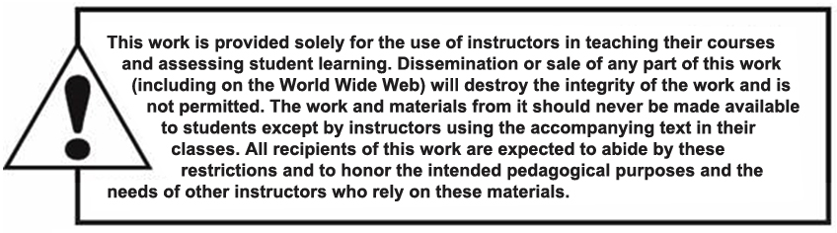
Copyright

Slide 65

kent.edu.au Kent Institute Australia Pty. Ltd. ABN 49 003 577 302 ● CRICOS Code: 00161E ● RTO Code: 90458 ● TEQSA Provider Number: PRV12051

